Slide 1

Simple Arcade game: SNAKE
Semester II (2021-2022)
Embedded Systems Course
Final Project Presentation
Course Code: CPE316
Supervisors: Dr. Iman Elawady ; ENG. Michael B.Khani
Team STRAWBERRIES members:
Enes Yurdatapan, 1810205079 * 1810205079@ogrenci.karabuk.edu.tr | Kamoliddin Fatkhiddinov, 1910205506 1910205506@ogrenci.karabuk.edu.tr
Ali Eren Ergün, 1810205041 1810205041@ogrenci.karabuk.edu.tr | Ahmat Soumaine, 1810205023 1810205023@ogrenci.karabuk.edu.tr
Ali Ramazan Taşdelen, 1910205003 alitasdelen@ogrenci.karabuk.edu.tr | Sevgican Kılıç, 1810205078 1810205078@ogrenci.karabuk.edu.tr
Batıkan Cımbıt, 1810205043 1810205043@ogrenci.karabuk.edu.tr | Oğuzhan Portakal, 1810205048 1810205048@ogrenci.karabuk.edu.tr
* Team leader and correspondent member

Slide 2

Contents
Introduction
Objectives
Conclusion
Project Design
References
Related Works
Application
Goals
Summary
Software
Hardware
Challenges
Results
Future works (Optional)

Slide 3
Introduction

Slide 4
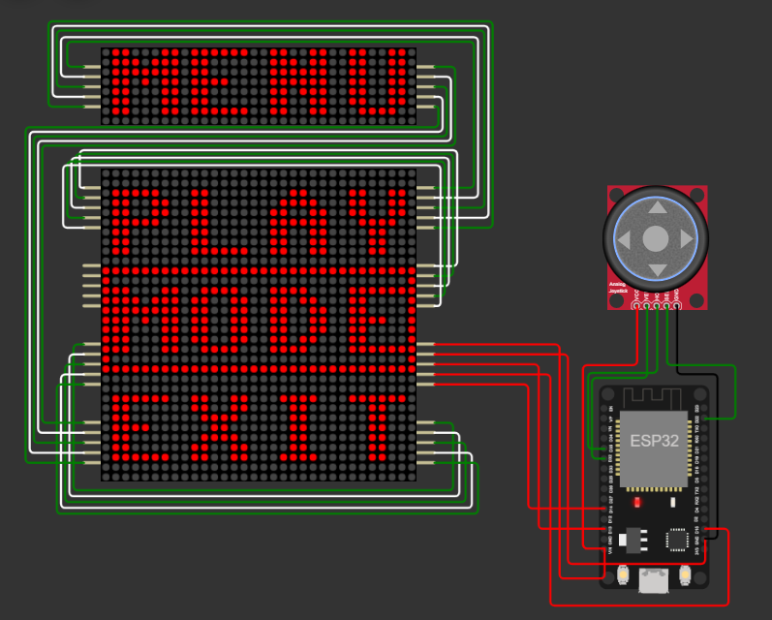
Introduction
Summary
Due to the increase in the demand for the entertainment sector and mobile devices, it is possible to see that the sales in this sector have been at the highest point recently.
One of the most important points of winning in this sector is to be able to promote the product very well and to produce it cheaply.

Slide 5
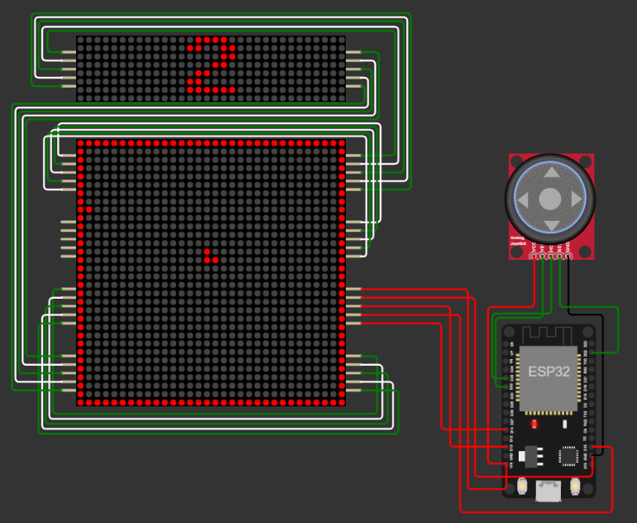
Introduction
Goals
We aimed to integrate traditional game which is an indispensable childhood enjoyment that people always remember, in a modern way.
We wanted to design it not only as a toy for children, but also for adults as a way of entertainment while waiting in line in anywhere or on a long journey.

Slide 6
Related Works

Slide 7
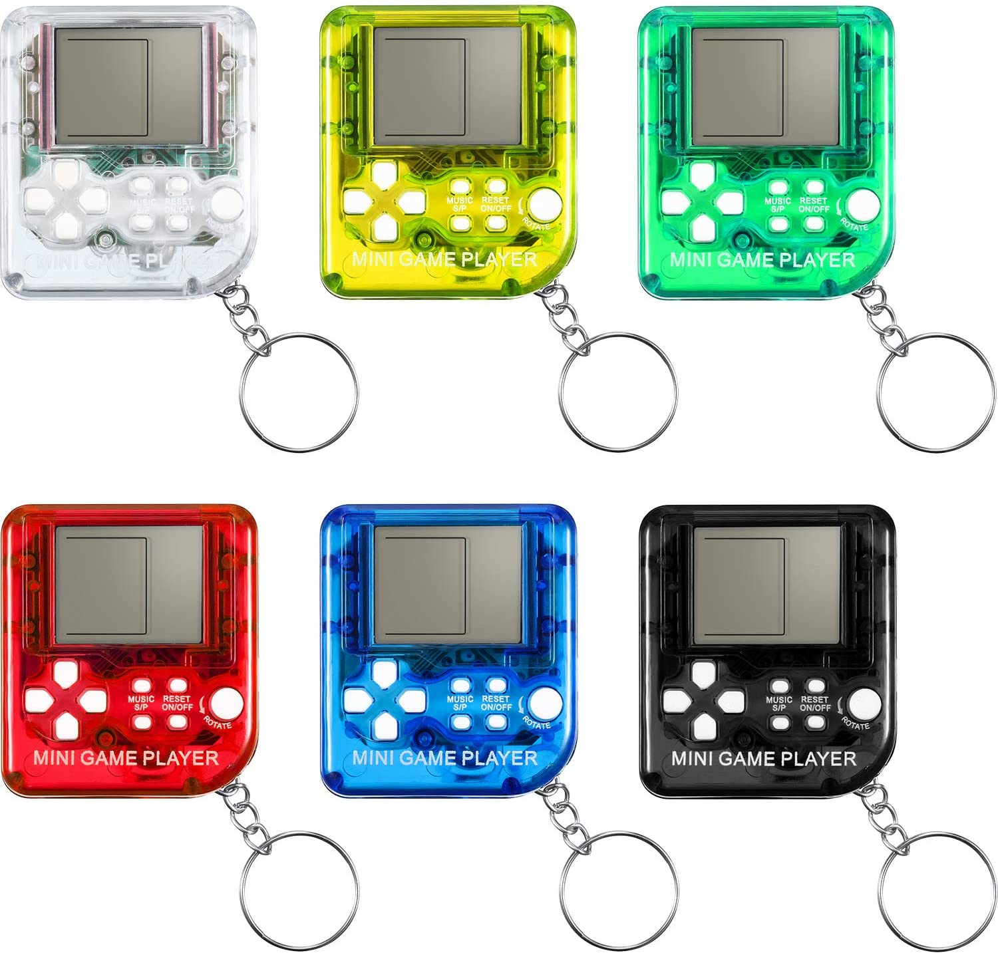
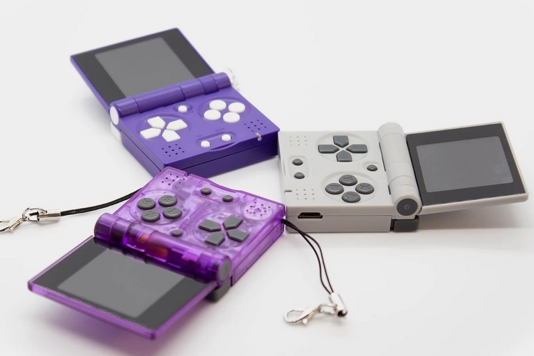
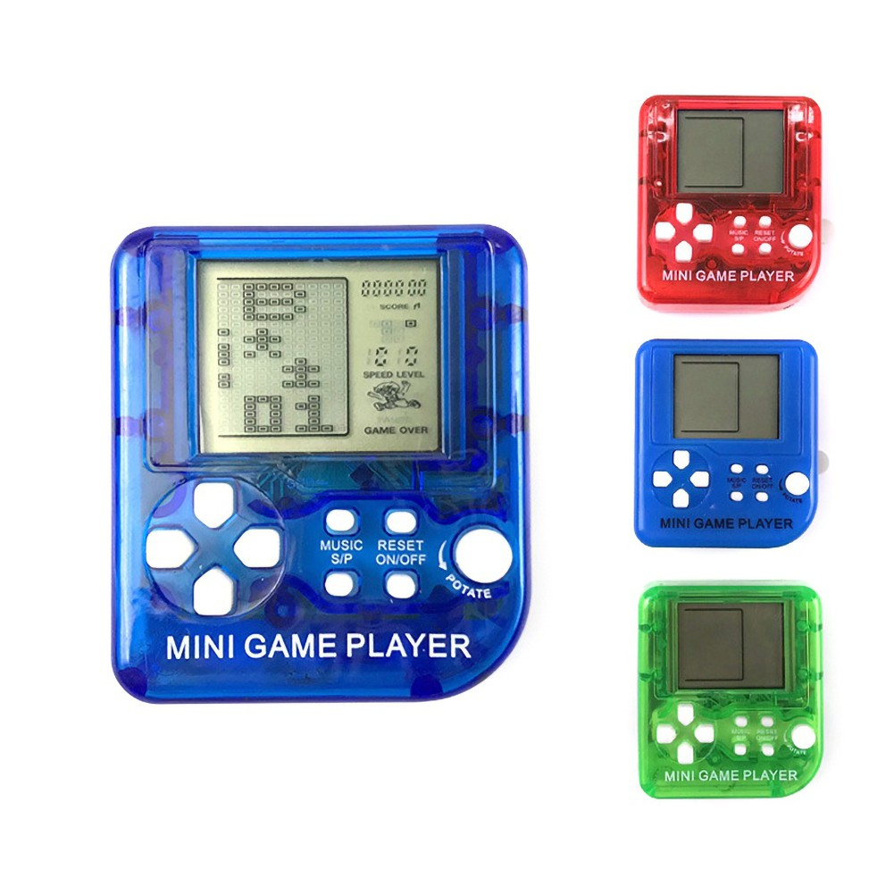
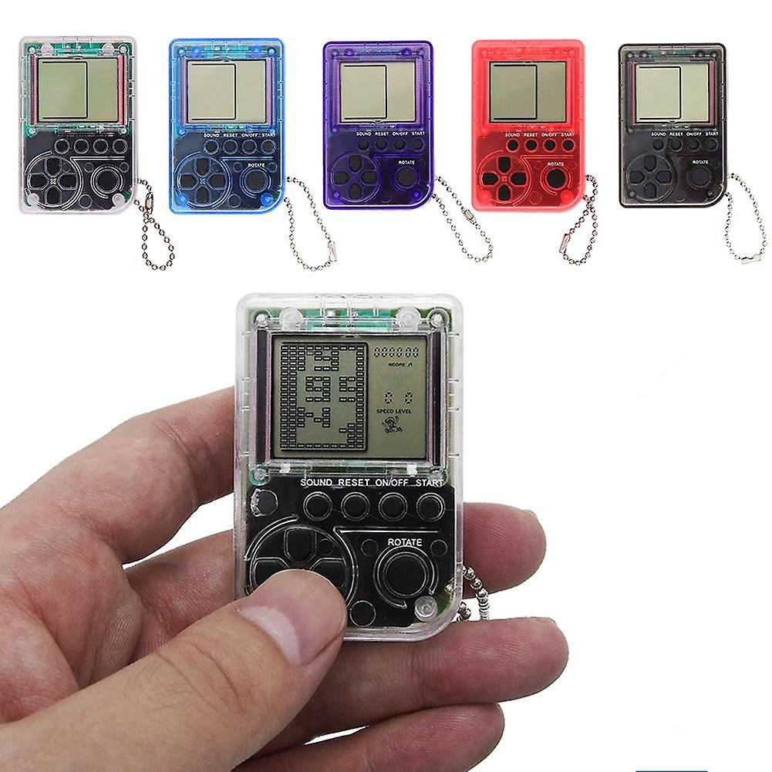
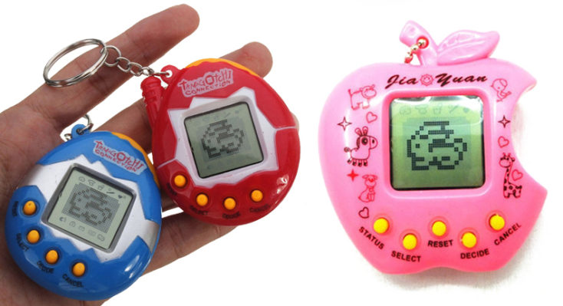
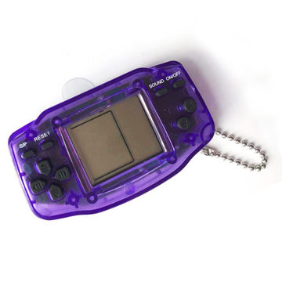
Related Works

Slide 8
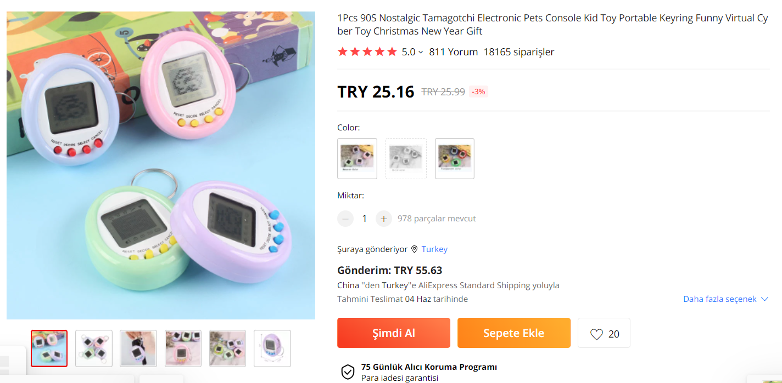
Related Works

Slide 9
Project Design

Slide 10

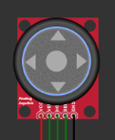
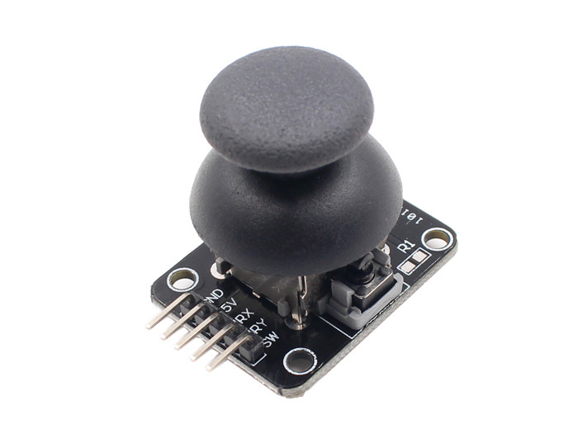
Project Design
To control the game used Analog Joystick as input hardware
Analog Joystick

Slide 11
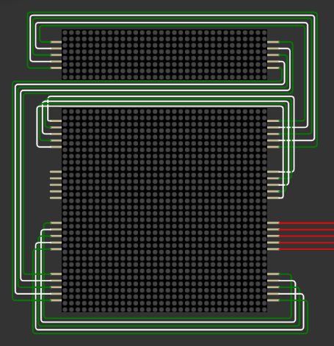
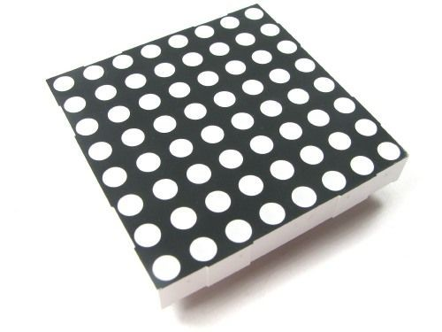
Project Design
8x8 LED Dot Matrix (MAX7219)
To display the game used 20 of 8x8 matrices connected to each other as output hardware

Slide 12
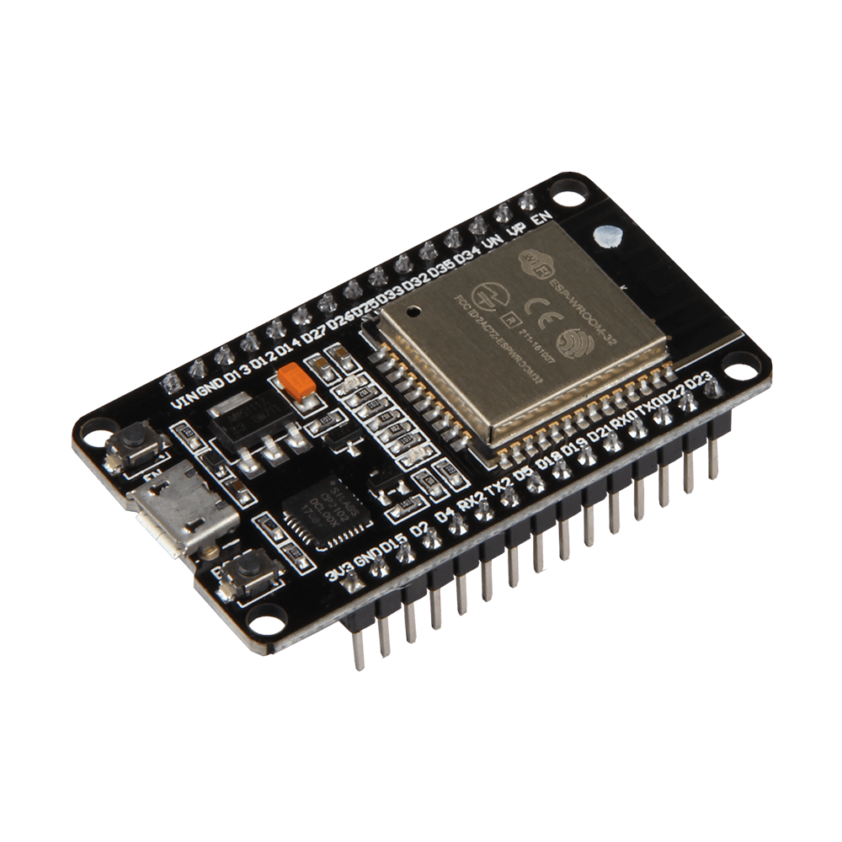
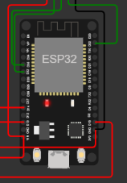

Project Design
ESP32
To control the game used ESP32 which connected input and output hardware

Slide 13
SOFTWARE

Slide 14
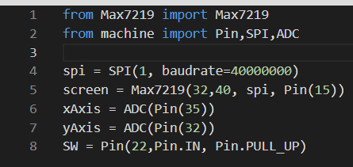
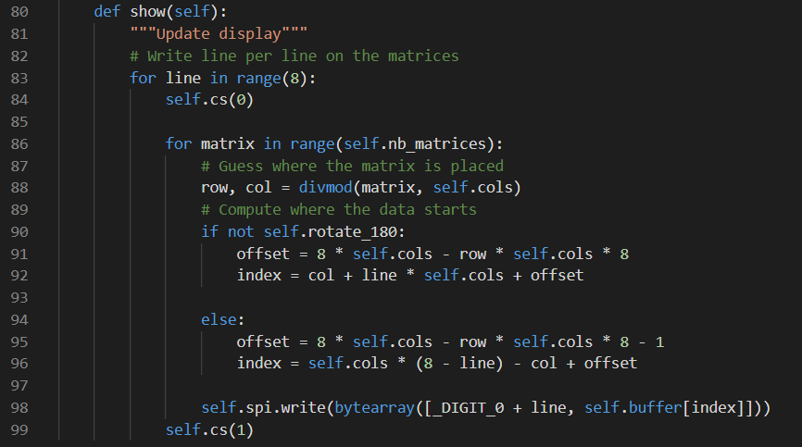
SOFTWARE
MAX7219 DRIVER
To drive and use a custom display we found opensource driver MAX7219. But unfortunately, driver didn’t work properly (e.g. driver displaying pixels upside down).
We changed some functions inside the library to make it suitable for our project.

Slide 15
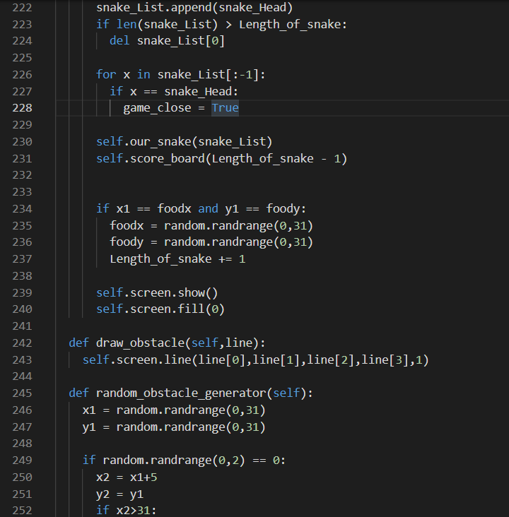
SOFTWARE
GAME ENGINE
We wrote code for Game Engine from scratch.
Tried to improve code maintenance.
Bunch of functions like Random Food and Obstacle Manager, Display and Mode Functions used together in a single Game Engine.

Slide 16
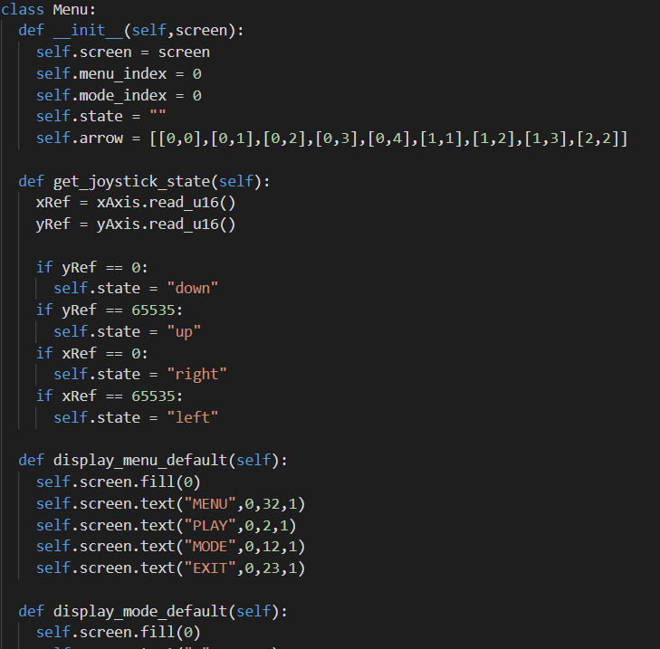
SOFTWARE
GAME MENU
To select game difficulty and play we used the menu.
For future usage it can be also implement to select another games (e.g. Tetris, Pong etc.)

Slide 17
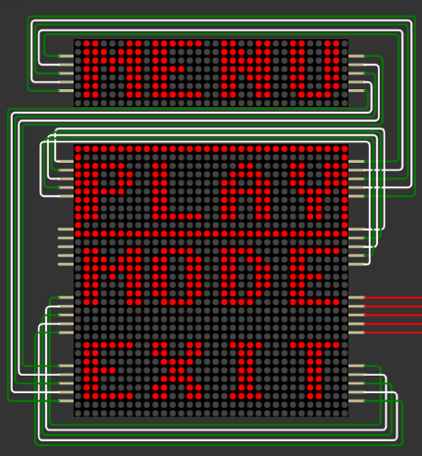
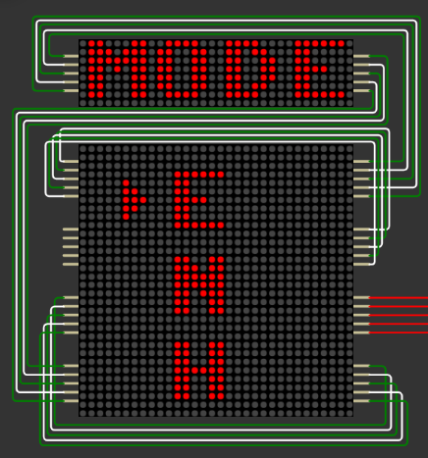
Game PHOTOS

Slide 18
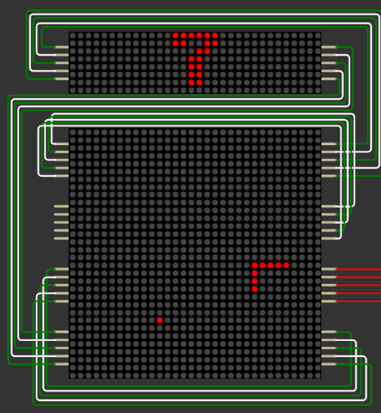
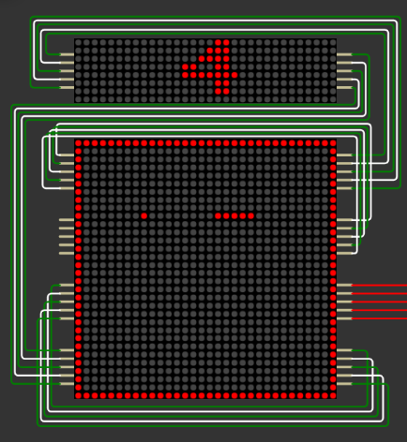
GAME MODES
EASY MODE
NORMAL MODE

Slide 19
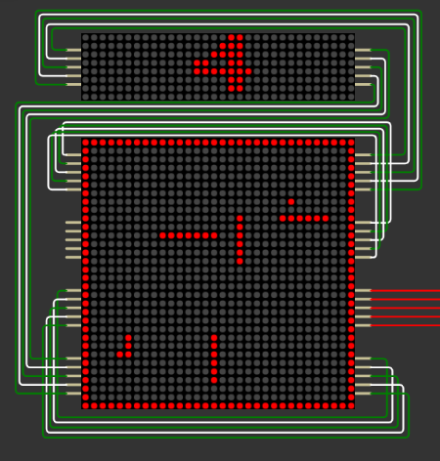
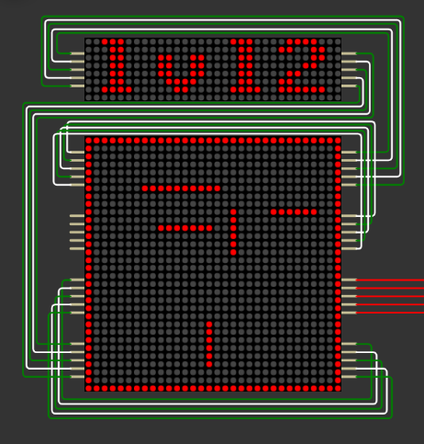
HARD MODE

Slide 20
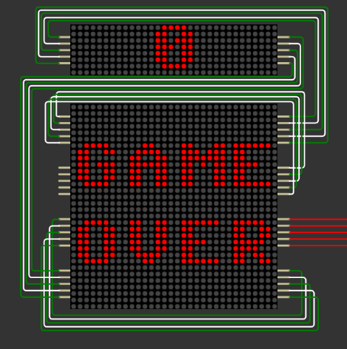
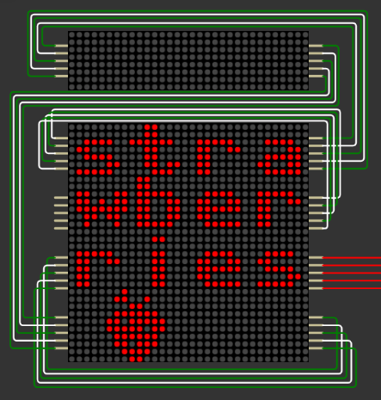
Game PHOTOS

Slide 21
Conclusion

Slide 22
Conclusion
Prototype was used for testing trade-offs and consistency of product.
As a result of the our project simulated in Wokwi environment we came to the conclusion of a physical product is plausible.
Most of project time used for software part was advantage of using a virtual environment and developing the game.
Due of simulation platform and python environment we can’t solve problems related to speed of the snake.(real baud rate differs from simulated one)

Slide 23
References
Arduino Simulator: Uno, Mega, ESP32, FastLED, LCD1602, Servo, Raspberry Pi Pico, Sensors. Designed for makers, by makers. https://wokwi.com/projects/328974406829212243
https://github.com/csdexter/MAX7219
https://github.com/coding-world/max7219
https://github.com/adafruit/Adafruit_CircuitPython_MAX7219
https://www.w3schools.com/python/

Slide 24
Thanks for listening

